Slide 1
Friction Notes

Slide 2
FRICTION DEFINED
The force that opposes the motion between
two surfaces that are in contact

Slide 3
Friction Characteristics
1. Friction acts parallel to the surfaces in contact and in the direction opposite to the motion of the object or to the force tending to produce such motion.
2. Friction depends on the nature of the materials in contact and the smoothness of their surfaces.
3. Sliding friction is less than or equal to starting friction.
4. Friction is virtually independent of surface area.
5. The friction force is directly proportional to the force
pressing the two surfaces together (the normal force).

Slide 4
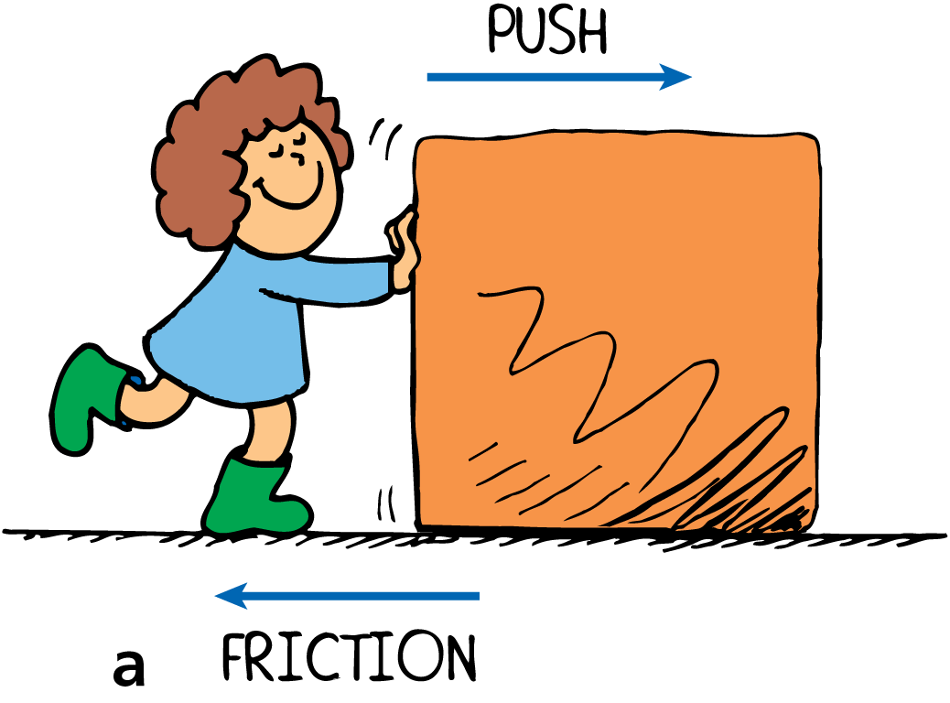
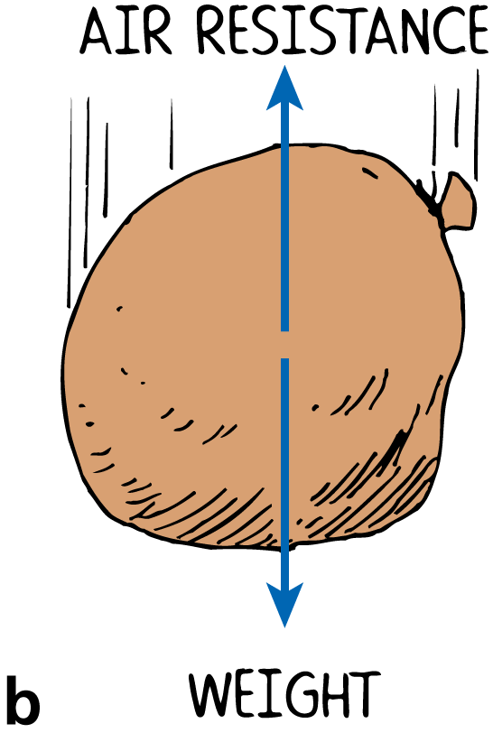
Friction
The direction of the force of friction always opposes the direction of motion.
a. Push the crate to the right and friction acts toward the left.
b. The sack falls downward and air friction acts upward.

Slide 5
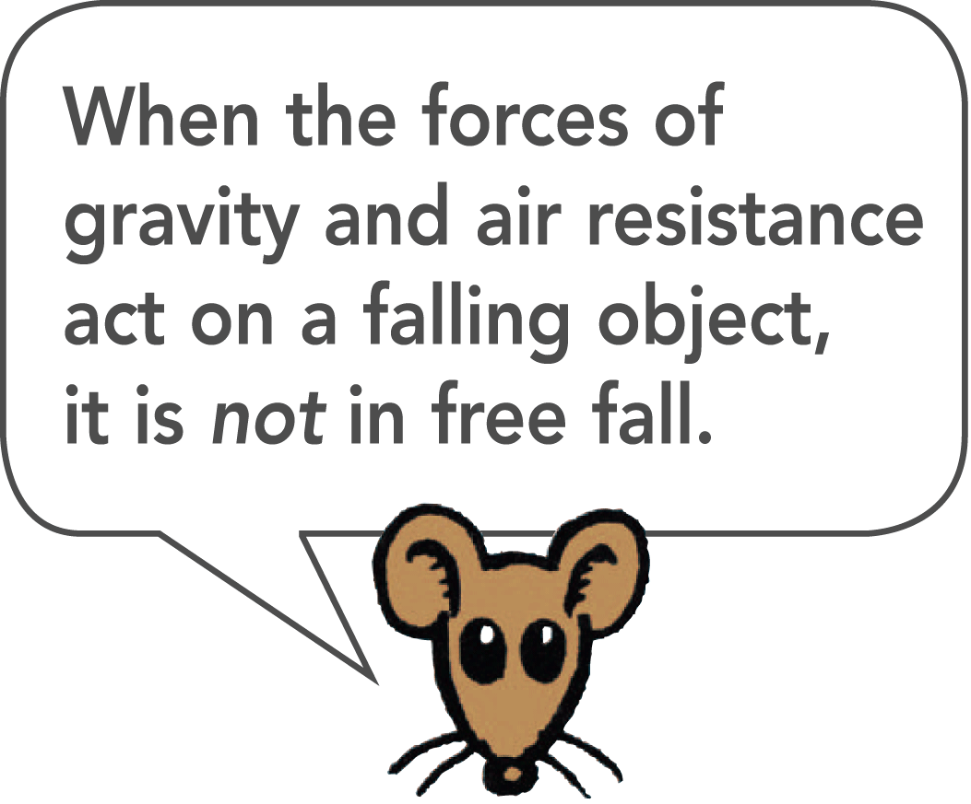
Falling and Air Resistance
The air resistance force an object experiences depends on the object’s speed and area.
A feather and a coin fall with equal accelerations in a vacuum, but very unequally in the presence of air.
When falling in air, the coin falls quickly while the feather flutters to the ground.
The force due to air resistance diminishes
the net force acting on the falling objects.

Slide 6
Falling and Air Resistance
Air resistance force ~ speed × frontal area
The expression shows that the air resistance force is directly proportional to the speed and frontal area of an object.

Slide 7
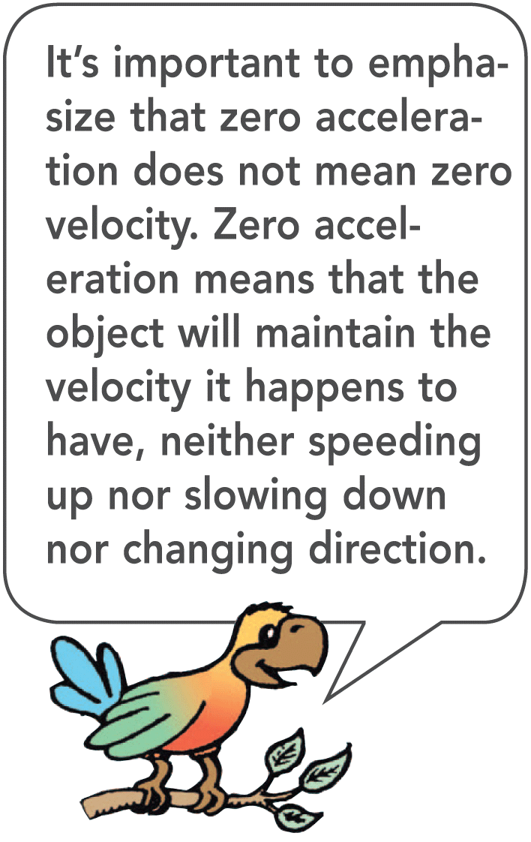
Terminal Speed
Terminal speed is the speed at which the acceleration of a falling object is zero because friction balances the weight.
Terminal velocity is terminal speed together with the direction of motion.

Slide 8
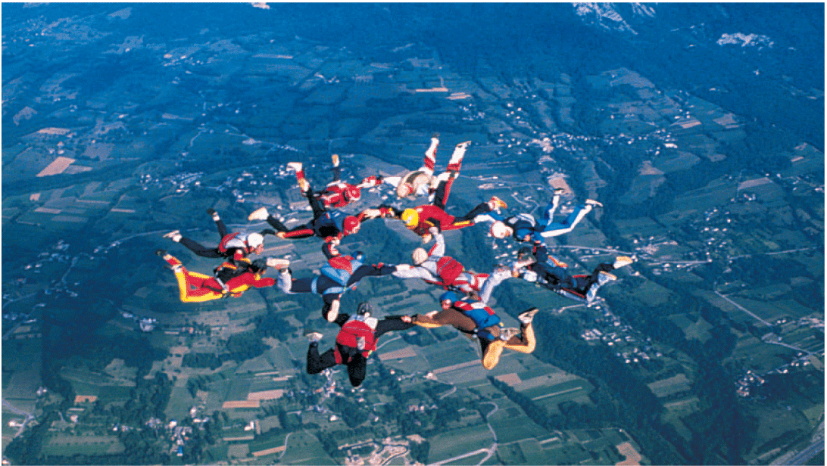
Sky divers reach terminal speed when air resistance equals weight.

Slide 9
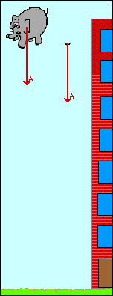
think!
Which experiences a greater air resistance force, a falling piece of paper or a falling elephant?
Answer: The elephant! It has a greater frontal area and falls faster than a piece of paper—both of which mean the elephant pushes more air molecules out of the way. The effect of the air resistance force on each, however, is another story!

Slide 10
Falling and Air Resistance
think!
If a heavy person and a light person open their parachutes together at the same altitude and each wears the same size parachute, who will reach the ground first?

Slide 11
Falling and Air Resistance
think!
If a heavy person and a light person open their parachutes together at the same altitude and each wears the same size parachute, who will reach the ground first?
Answer: The heavy person will reach the ground first. Like a feather, the light person reaches terminal speed sooner, while the heavy person continues to accelerate until a greater terminal speed is reached.

Slide 12
Calculating Friction
The ratio of the friction force, F_{f},
to the normal force, F_{n}, is called
the coefficient of friction, μ.
F_{f}
μ has
no units.
μ =
F_{n}

